Slide 1
Queue

Slide 2
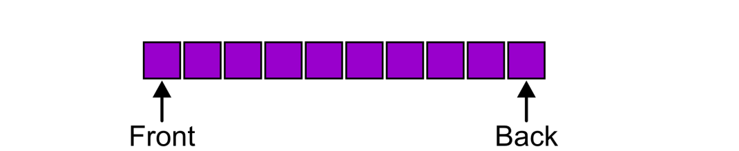
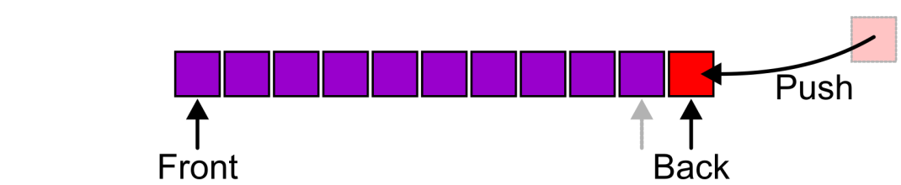
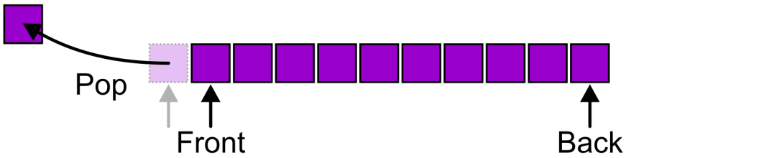
Queue introduction
Queue is a linear data structure which the elements are inserted from one end called rear (tail) and removing the element from the other end called front (head). Queue operates data in the first in first out “FIFO” manner.

Slide 3
Queue as ADT
A queue is a special kind of data structure with finite sequence of elements with the operations
MakeEmpty(): creates an empty queue
IsEmpty(): checks whether the queue is empty or not
IsFull(): checks whether the queue is full or not
Enqueue(): add an item at the rear of the queue, if and only if the queue is not full
Dequeue(): delete an item from the front of the queue if and only if the queue is not empty
Traverse(): displays the entire content of the queue.

Slide 4
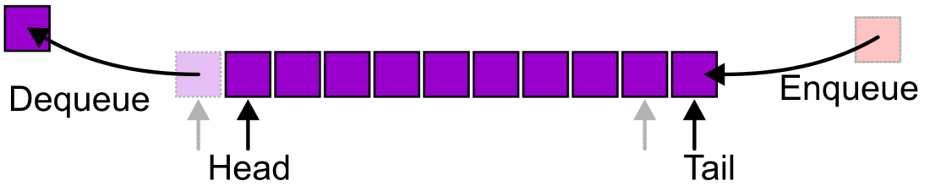
Queue Operations
Enqueue(): the process of inserting data elements into the queue is called enqueue operation
Dequeue(): The process of removing the data elements from the queue is called dequeue operation
Status check operation: Empty and full condition
isFull: it determines the status of queue is full or not.
isEmpty: it determines the status of queue is empty or not
QueueType: Generally two types of Queue
Linear Queue
Circular Queue

Slide 5
Queue Operations
Linear Queue has two types: Head vary queue and Head fix queue
Head Vary Queue: Both head and tail will change. After inserting data into the queue the tail increase by 1 and head increase after removing the data. The queue will be empty if head and tail have same value head=tail=0
Head Fix Queue: head remain fixed. Only tail will change after removing or inserting the data into or from the queue.

Slide 6
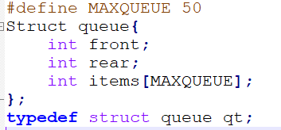
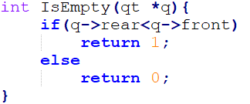

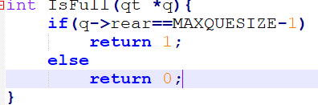
Queue Operations
Queue Declaration
Checking whether queue is empty
Checking whether queue is Full
Creating queue

Slide 7
Queue Operations
Head fix queue
Head vary queue
For enqueue operation
IF rear>=MaxSize-1
Print “Queue is Full !”
ELSE
rear=rear+1
queue[rear]=item
For De-queue operation
IF rear=-1
Print “ queue is Empty”
ELSE
Item=queue[rear]
swap the elements from upper to one step lower
rear=rear-1
For En-queue operation
IF rear>=MaxSize-1
Print”Queue is Full !”
ELSE
rear=rear+1
queue[rear]=item
For De-queue operation
IF front>rear
Print “Queue is Empty!”
ELSE
Item=queue[front]
front=front+1

Slide 8
Examples
Enqueue 10
 | 10
Head=0
Tail =1
Enqueue 20
 | 10 | 20
Head=0
Tail =2
Enqueue 30
 | 10 | 20 | 30
Head=0
Tail =3
Enqueue 40: Error Queue is full
dequeue 10
 | 20 | 30
Head=0
Tail =2
dequeue 20
 | 30
Head=0
Tail =1
dequeue 30
Head=tail=0
Afterward dequeue operation generates error message

Slide 9
Examples
enqueue 10
 | 10
Head=0
Tail =1
enqueue 20
 | 10 | 20
Head=0
Tail =2
dequeue 10
 |  | 20
Head=1
Tail =2
enqueue 30
 |  | 20 | 30
Head=1
Tail =3
dequeue 20
 |  |  | 30
Head=2
Tail =3
dequeue 30
Head=Tail =3
Afterward dequeuer/enqueue operation generates error message

Slide 10
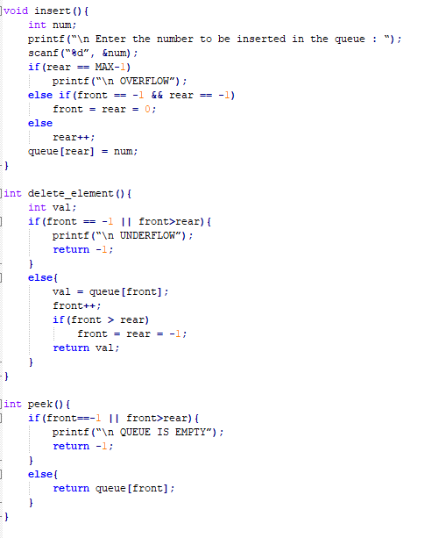
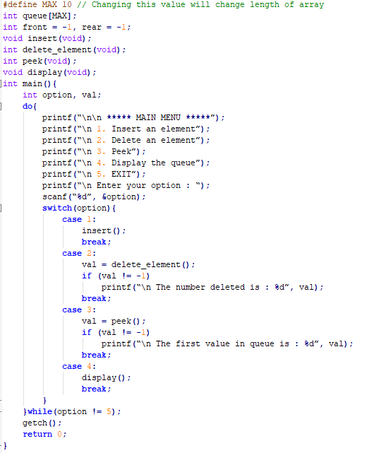
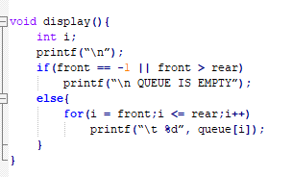
Menu program using Queue

Slide 11
Application of Queue
The most common application is in client-server models
Multiple clients may be requesting services from one or more servers
Some clients may have to wait while the servers are busy
Those clients are placed in a queue and serviced in the order of arrival
Grocery stores, banks, and airport security use queues
The SSH Secure Shell and SFTP are clients
Most shared computer services are servers:
Web, file, ftp, database, mail, printers, WOW, etc.

Slide 12
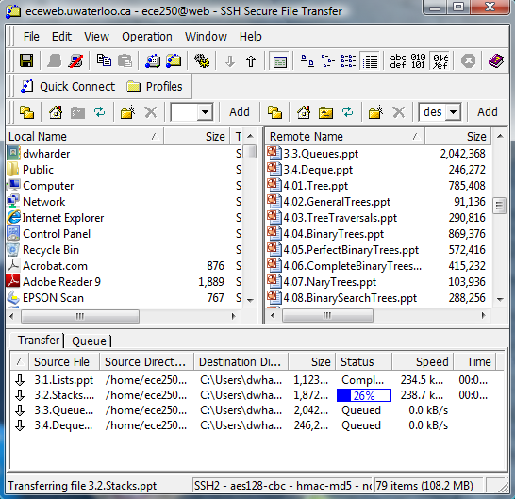
Application of Queue
For example, in downloading these presentations from the ECE 2F0 web server, those requests not currently being downloaded are marked as “Queued”

Slide 13
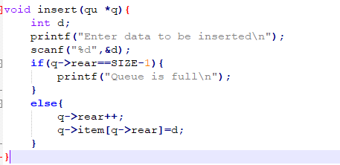
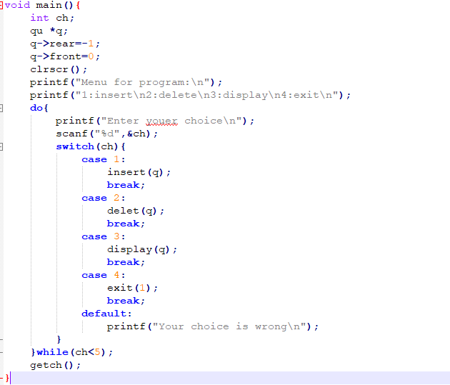
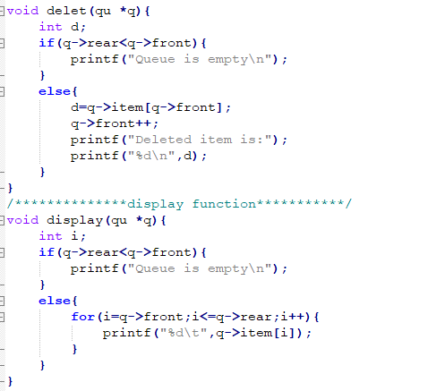
Queue

Slide 14
Limitation of linear queue
0
1
2
3
4
F
6
7
 | 4 | F | 6 | 90
front
rear
0
1
2
3
4
F
6
7
 | 4 | F | 6 | 90 | 22 | 14 | 6F
front
rear
When we enqueue three more elements then the queue becomes full, however there is still some space left blank
Similar for dequeuer operation see previous example

Slide 15
Circular Queue
The last element is connected back to the first to make a circle. Circle queue is linear data structure and follows FIFO principle.
A circular queue is one in which the insertion of a new element is done at the very first location of the queue if the last location at the queue is full.
Elements are added at the tail end and the elements are deleted from the front end of the queue

Slide 16
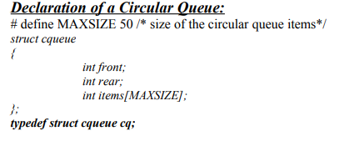
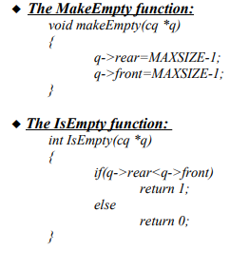
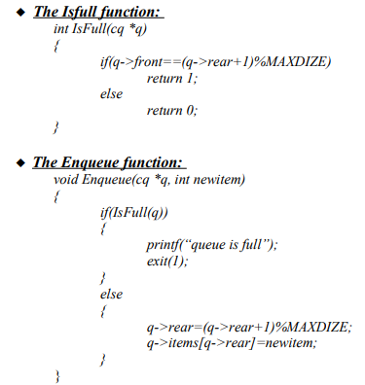
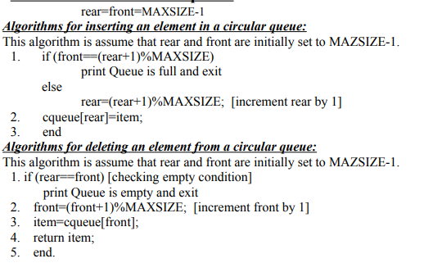
Circular Queue

Slide 17
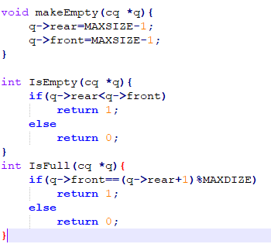
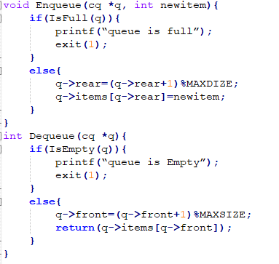
Circular Queue operations
makeEmpty()
Enqueue()
CheckEmpty()
dequeue()
CheckFull()

Slide 18
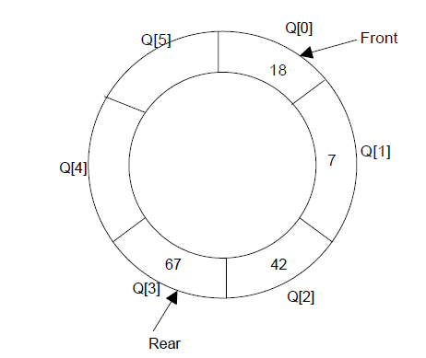
Circular Queue
Suppose Q is a queue array of 6 elements. Push and pop operation can be performed on circular. The following figures will illustrate the same.
A circular queue after inserting 18, 7, 42, 67

Slide 19
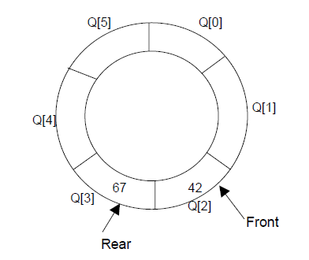
Circular Queue
After inserting an element at last location Q[F], the next element will be inserted at the very first location (i.e., Q[0]) that is circular queue is one in which the first element comes just after the last element.
A circular queue after popping 18, 7

Slide 20
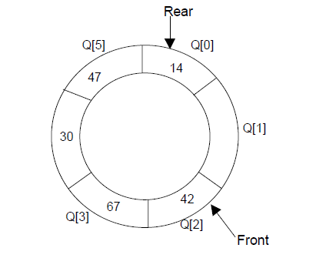
Circular Queue
At any time the position of the element to be inserted will be calculated by the relation Rear = (Rear + 1) % SIZE
After deleting an element from circular queue the position of the front end is calculated by the relation Front= (Front + 1) % SIZE
After locating the position of the new element to be inserted, rear, compare it with front. If (rear = front), the queue is full and cannot be inserted anymore.
A circular queue after pushing 30, 47, 14

Slide 21
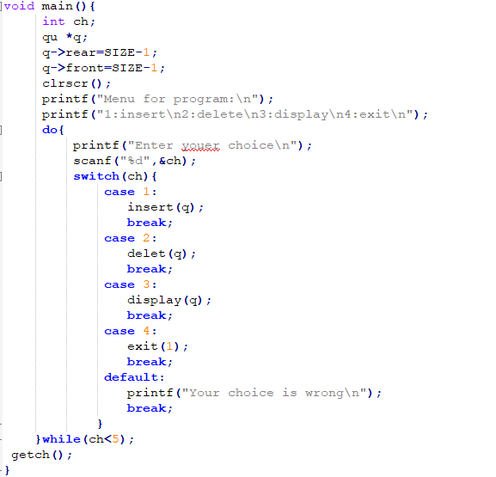
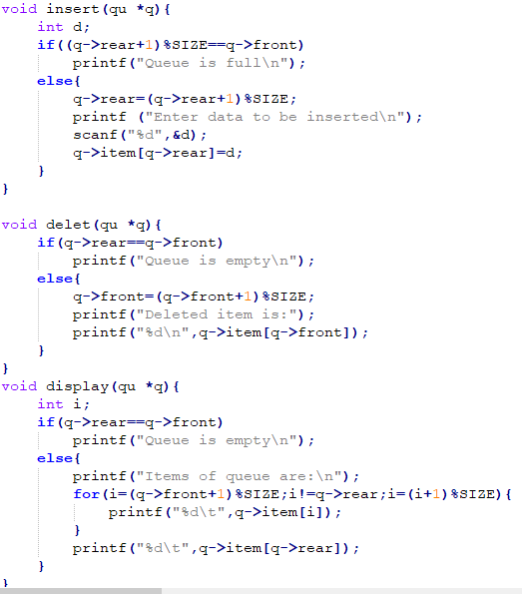
Circular Queue

Slide 22
Priority Queue
A priority queue is a collection of elements such that each element has been assigned a priority and the order in which elements are deleted and processed comes from the following rules:.
An element of higher priority is processed before any element of lower priority.
If two elements has same priority then they are processed according to the order in which they were added to the queue.
The best application of priority queue is observed in CPU scheduling.
✔ The jobs which have higher priority are processed first.
✔ If the priority of two jobs is same this jobs are processed according to their position in queue.
✔ A short job is given higher priority over the longer one.
In normal queue structure, insertion is performed at the end of the queue and deletion is performed on the FIFO principle

Slide 23
Priority Queue
Example:
R1:20 | R2:2 | R3:10 | R4:F
Front
Rear
Arrival Request based priority
R1:20 units of time
R2:22 units of time (R2 must wait till R1 completes-20 units and R2 itself requires 2 units total 22 units)
R3:32 units of time (R3 must wait till R2 complete -22 units and R3 itself requires 10 units total 32 units)
R4:37 units of time (R4 must wait till R3 completes -3F units and R4 itself requires F unit total 37 units)
Average waiting time for all request is ≈27 units of time
Time required to completed the task based priority
R2:2 units of time
R4:7 units of time (R4 must wait till R2 completes)
R3:17 units of time (R3 must wait till R4 completes)
R1:37 units of time (R1 must wait till R3 completes)
Average waiting time for all request is ≈1F units of time

Slide 24
Priority Queue
Types of priority queues
Ascending priority queue(min priority queue): An ascending priority queue is a collection of items into which items can be inserted arbitrarily but from which only the smallest item can be removed.
isEmpty()
insert()
findMin()
remove()
Descending priority queue(max priority queue): An descending priority queue is a collection of items into which items can be inserted arbitrarily but from which only the largest item can be removed.
isEmpty()
insert()
findMax()
remove()

Slide 25
Priority Queue
The priority queue ADT:
A ascending priority queue of elements of type T is a finite sequence of elements of T together with the operations:
MakeEmpty(): Create an empty priority queue p
Empty(): Determine if the priority queue p is empty or not
Insert(): Add element x on the priority queue p
DeleteMin(): If the priority queue p is not empty, remove the minimum element of the quque and return it.
FindMin(): Retrieve the minimum element of the priority queue p.

Slide 26
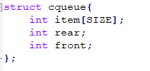
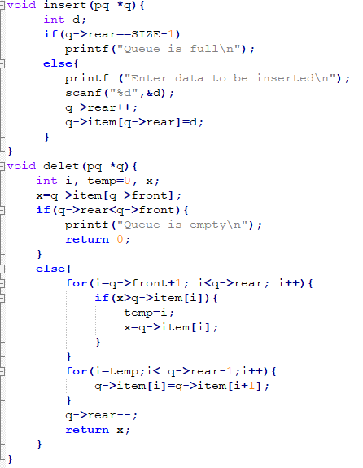
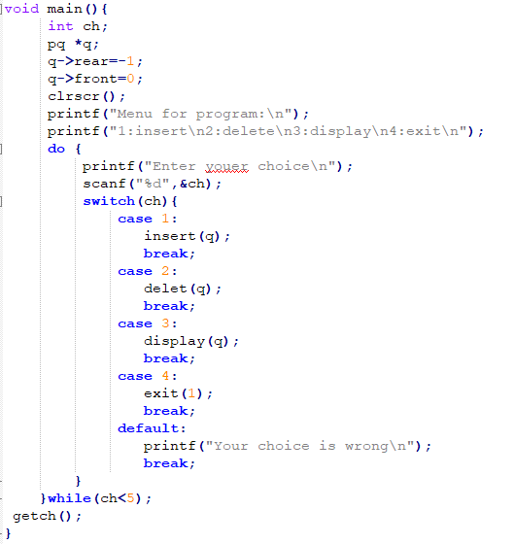
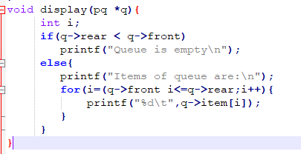
Priority Queue
Notes:
#include<stdio.h>
#include<conio.h>
#define SIZE 20
struct cqueue
{
int item[SIZE];
int rear;
int front;
};
typedef struct queue pq;
void insert(pq*);
void delet(pq*);
void display(pq*);
void main(){
int ch;
pq *q;
q->rear=-1;
q->front=0;
clrscr();
printf("Menu for program:\n");
printf("1:insert\n2:delete\n3:display\n4:exit\n");
do {
printf("Enter youer choice\n");
scanf("%d",&ch);
switch(ch){
case 1:
insert(q);
break;
case 2:
delet(q);
break;
case 3:
display(q);
break;
case 4:
exit(1);
break;
default:
printf("Your choice is wrong\n");
break;
}
}while(ch<F);
getch();
}
void insert(pq *q){
int d;
if(q->rear==SIZE-1)
printf("Queue is full\n");
else{
printf ("Enter data to be inserted\n");
scanf("%d",&d);
q->rear++;
q->item[q->rear]=d;
}
}
void delet(pq *q){
int i, temp=0, x;
x=q->item[q->front];
if(q->rear<q->front){
printf("Queue is empty\n");
return 0;
}
else{
for(i=q->front+1; i<q->rear; i++){
if(x>q->item[i]){
temp=i;
x=q->item[i];
}
}
for(i=temp;i< q->rear-1;i++){
q->item[i]=q->item[i+1];
}
q->rear--;
return x;
}
}
void display(pq *q){
int i;
if(q->rear < q->front)
printf("Queue is empty\n");
else{
printf("Items of queue are:\n");
for(i=(q->front i<=q->rear;i++){
printf("%d\t",q->item[i]);
}
}
}

Slide 27
Deques
A deque is a homogeneous list in which elements can be added or inserted (called push operation) and deleted or removed from both the ends (which is called pop operation).
Add a new element at the rear or front end and also remove an element from both front and rear end. ➔ Double Ended Queue.
front
rear
deletion
addition
deletion
addition

Slide 28
Deques
Two types of deque depending upon the restriction to perform insertion or deletion operations at the two ends.
Input restricted deque: allows insertion at only one end, rear end, but allows deletion at both ends, rear and front end of the lists.
Output restricted deque: allows deletion at only one end, front end, but allows insertion at both ends, rear and front ends, of the lists.
front
rear
deletion
deletion
addition
front
rear
deletion
deletion
addition
addition

Slide 29
Deque
The possible operation performed on deque is
1. Add an element at the rear end
2. Add an element at the front end
3. Delete an element from the front end
4. Delete an element from the rear end
operations are performed by input-restricted deque and operations are performed by output-restricted deque.
1st , 3rd and 4th
1st , 2nd and 3rd

Slide 30
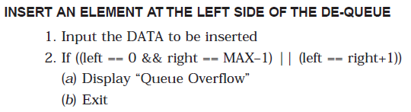
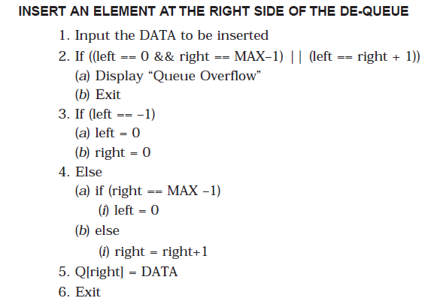
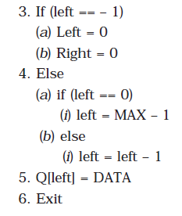
Deque

Slide 31
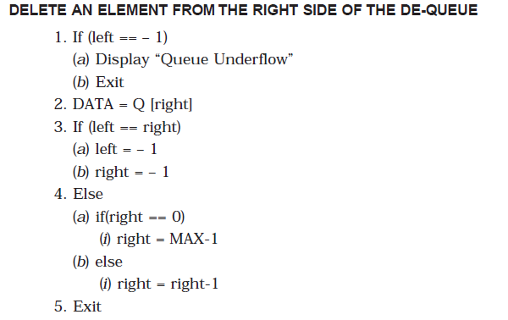
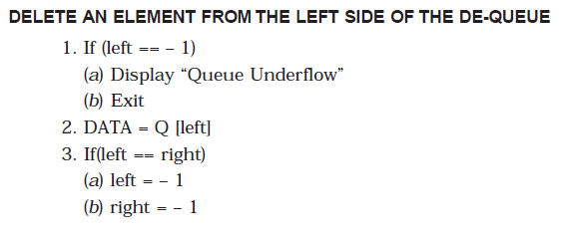
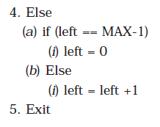
Deque

Slide 32
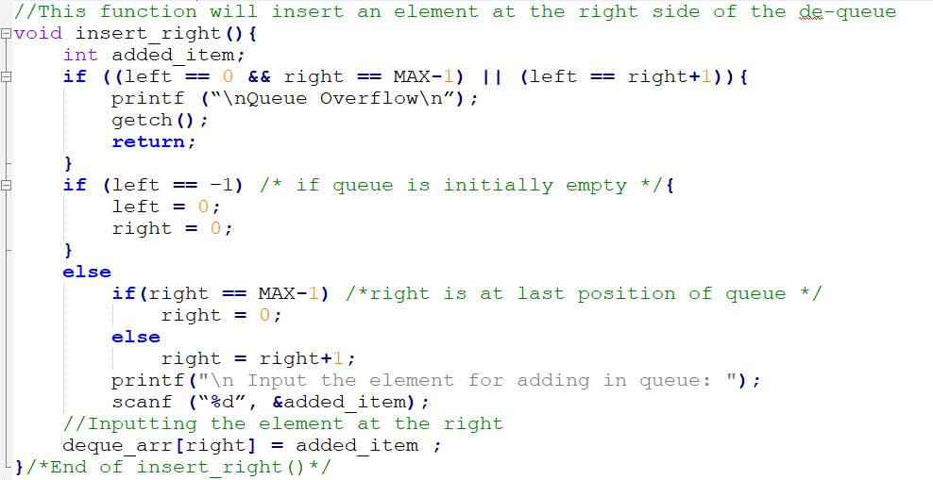
Deque
Insert Element at the right side of the deque

Slide 33
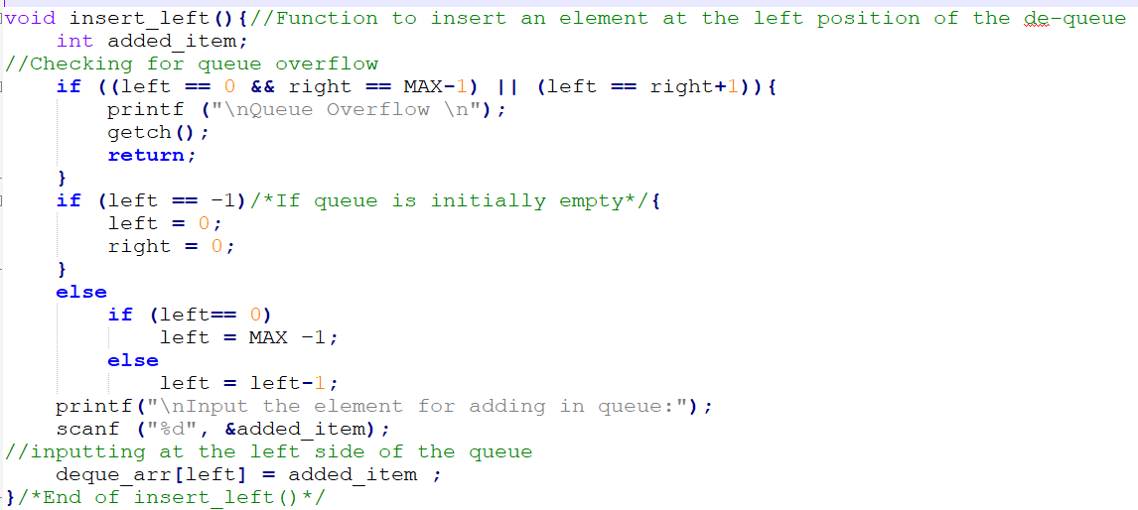
Deque
Insert Element at the left side of the deque

Slide 34
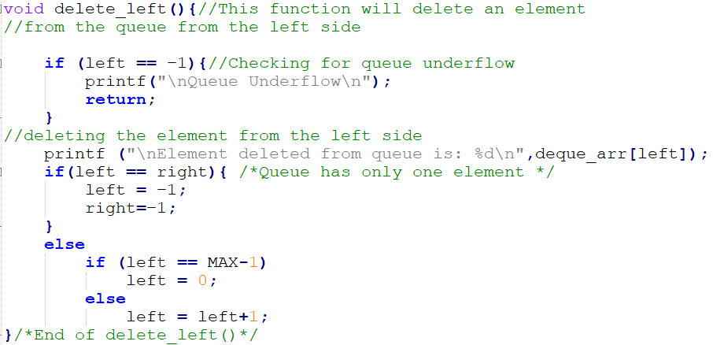
Deque
delete Element from the left side of the deque

Slide 35
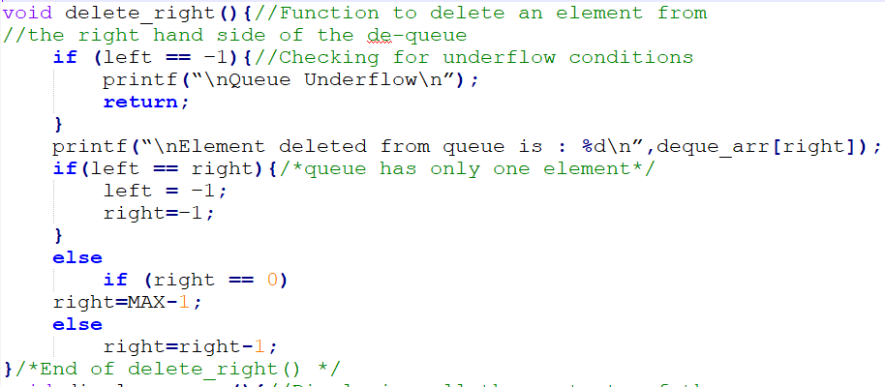
Deque
delete Element from the right side of the deque

Slide 36
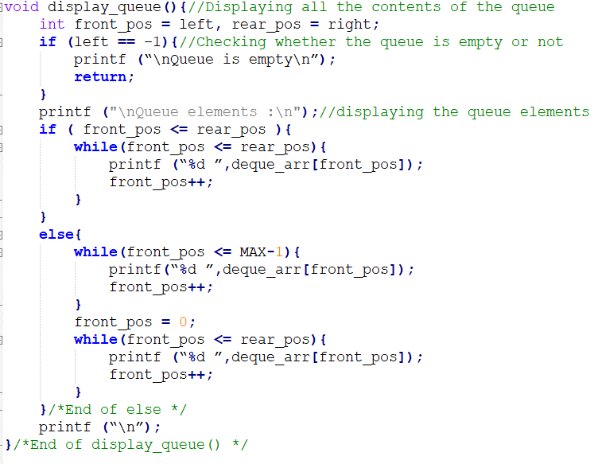
Deque
Display element of deque

